Slide 1

“Read me where you left me”
Final Year Project Presentation

Slide 2

Hello!
We are Team SS17/3D
Name | Student ID | Role
Abhi Jay Krishnan | 5025448 | Project Manager, Design Lead
Kim Hyeocheol | 5026052 | QA Lead
Rivaldo Erawan | 5026374 | Development Lead
Durrah Afshan | 5025916 | Analyst

Slide 3
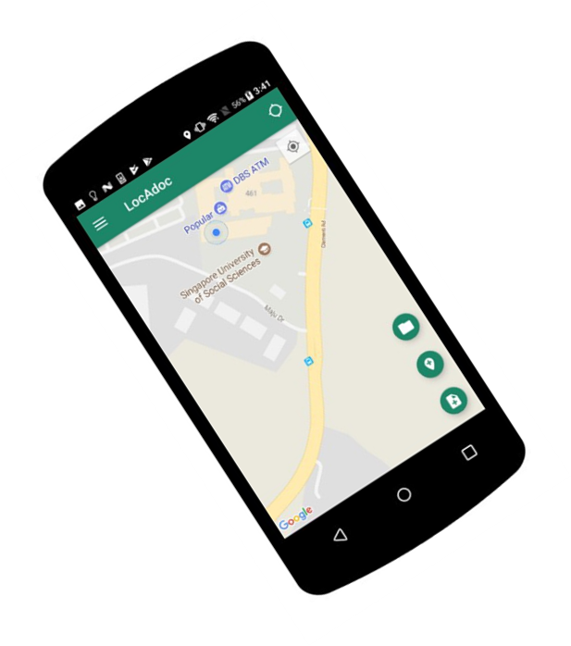

Revolutionize document safety! Store and view files in secure locations.

Slide 4
Problems addressed by the product
Provide an encryption mechanism that require two conditions to be satisfied namely : -
Password
Predefined trusted location (radius) .
An access control mechanism based on the location of the user.
Ability to recover documents in case the scenario of phone being lost and flexibility of accessing it over multiple devises.

Slide 5
Market Survey

Slide 6
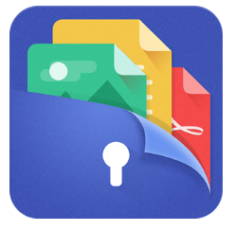



File Locker – Lock Any File
File Locker
Some feature that the products lack are:-
Password recovery
Encryption of files is not location based

Slide 7
Product Architecture

Slide 8



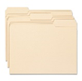
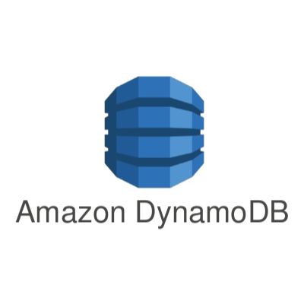


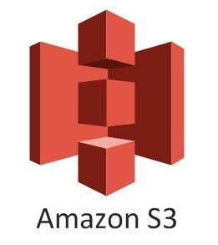
Client Cloud Architecture
Application Layer
Cloud
Amazon Cognito
Provisional
Database
Local Storage
Authentication
Database
Uses
User
Backup Data

Slide 9
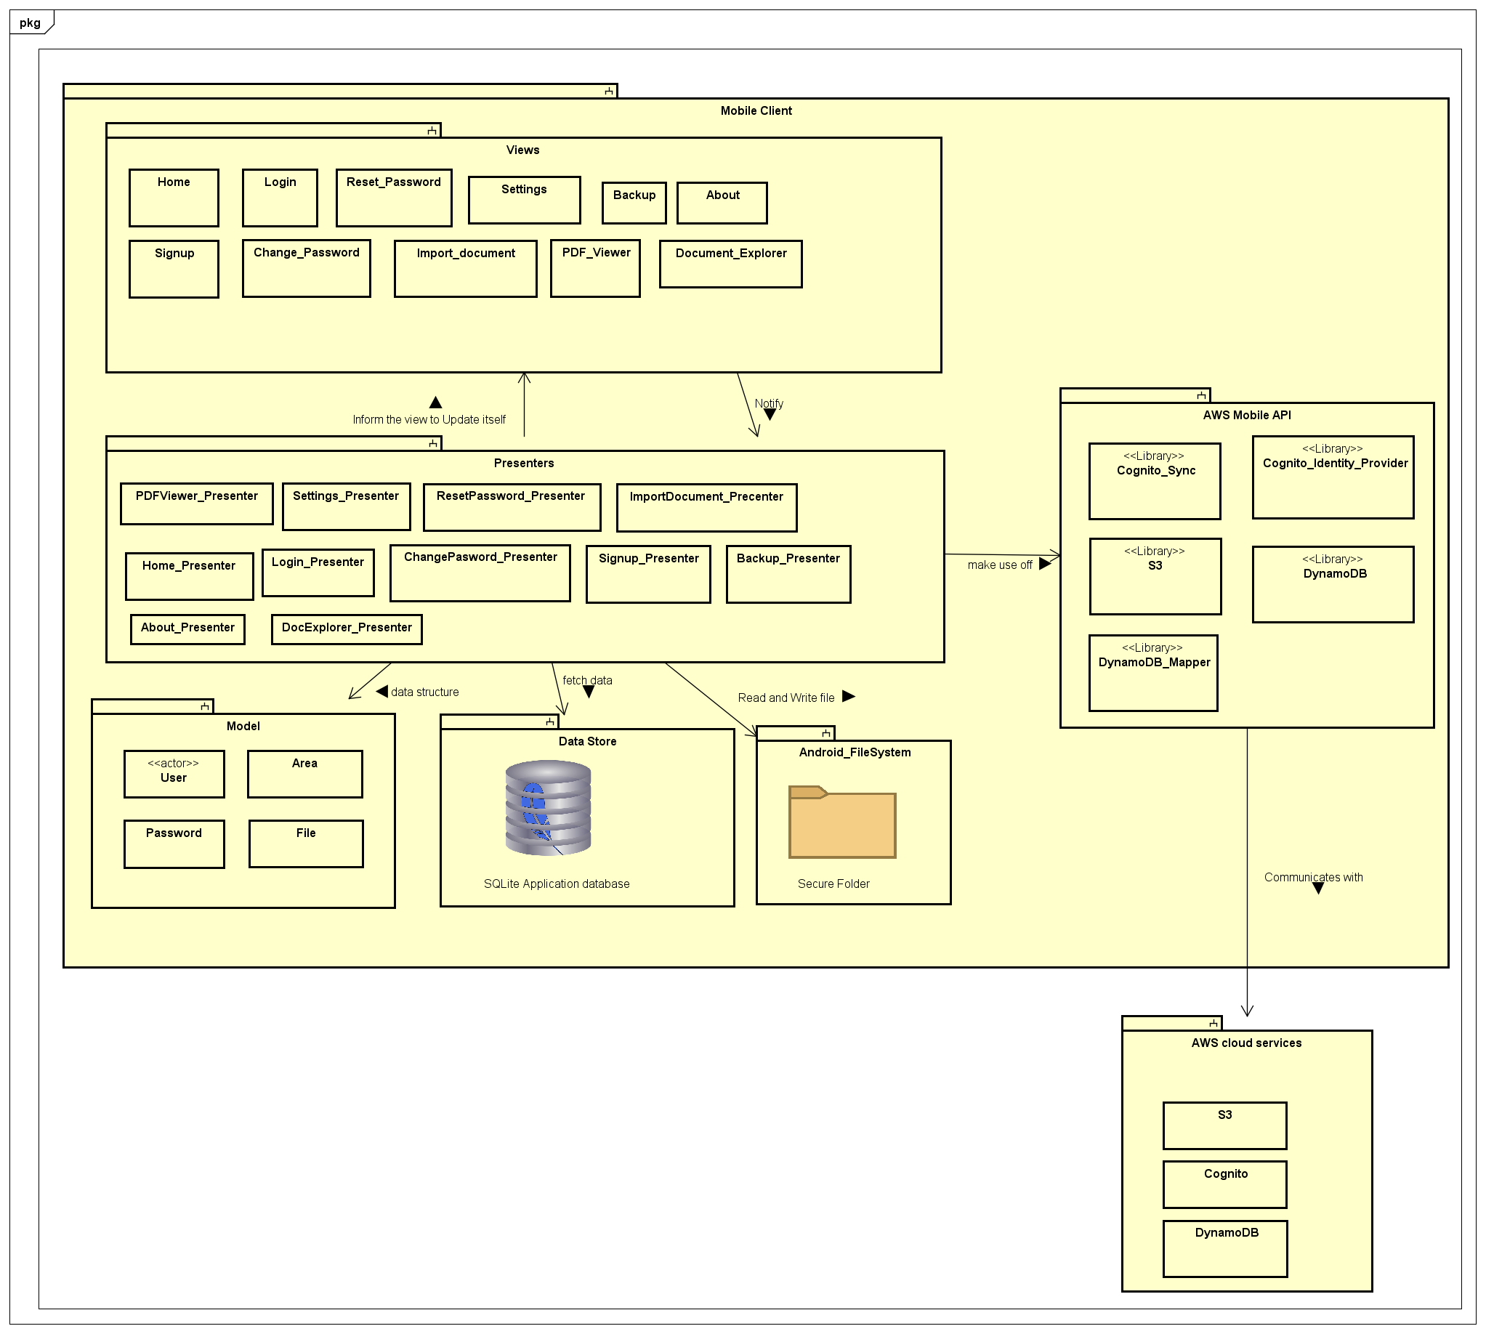
Layer diagram

Slide 10
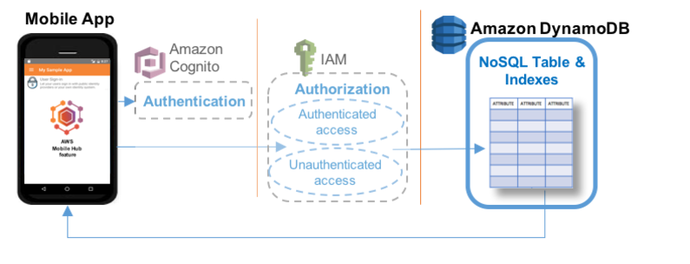
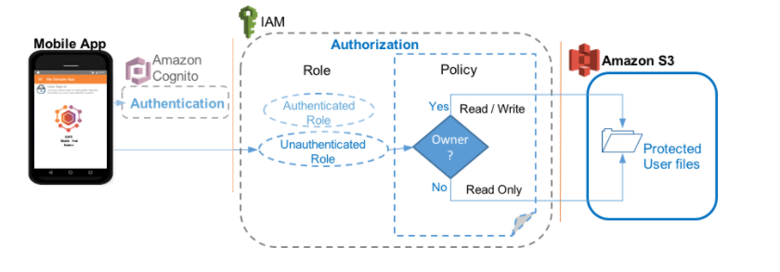
Authentication Flow
DynamoDB Authentication flow
S3 Authentication flow

Slide 11
Product Features

Slide 12

Access control mechanism
based on users current location
PDF viewer
Map view displaying area and radius
Access over multiple devices
Search, delete and modify
area
User can destroy the local copy of file
All user files and data are encrypted and some other security mechanism
Secure cloud storage

Slide 13
Some special features
Detecting GPS spoofing.
Detecting multiple login.
Restricted login attempts.
Password recovery.
PDF viewer stay closes when user move out of the location.

Slide 14
Future Projection
An enterprise version of the application where the administrator allocates the files and area. The employees can access those files within designated area.
We can incorporate more file types and add more viewers within the application. This will improve the user experience.
Lastly there can be a payment system to increase the storage space. This will help the user to scale as per the demand.

Slide 15
What have we learned ?
How to design and develop an android application.
API’s such as AWS and Google Map.
Team work.
Version control (Git flow).
Non technical aspects (Business modelling)
Regression testing

Slide 16
Thank you!
Q & A

